Slide 1
Quaternion Math and other Rotation Representations
Michael stanley
NXP Semiconductor Sensors Division
28 April 2017

Slide 2
Course Outline
Basics Review
Euler Angles
Axis Angle Representations
Rotation Matrices
Quaternions
Final Observations

Slide 3
Some Basics

Slide 4
Movement in Space
Any movement from point A to point B can be decomposed into a translation plus optional rotation
Ψ
ΔY
ΔX
We need at least 6 degrees of freedom (DOF) to describe a movement in 3 dimensions: ΔX, ΔY, ΔZ, Φ, θ, Ψ
Roll Pitch Yaw

Slide 5
Euler’s Theorem
Any two independent orthonormal coordinate frames can be related by a sequence of rotations (not more than three) about coordinate axes, where no two successive rotations may be about the same axis.
- Leonard Euler (1707-1783)
Source: CSE169: Computer Animation Class Notes, Instructor: Steve Rotenberg UCSD, Winter 2005

Slide 6


There can be multiple, concurrent, frames of reference
Up
Body or Device Reference Frame
East
Earth Frame
North
The device orientation can be defined as the rotation necessary to map the global frame of reference into alignment with the body frame of reference (or vice versa).

Slide 7
Frames of Reference
Most systems use a Cartesian frame of reference, but which one?
+Y = East
+X = North
+Z = Up
NED
+X = East
+Z = Down
+Y = North
ENU
Aeronautics uses NED
Windows 8 and Android use ENU

Slide 8
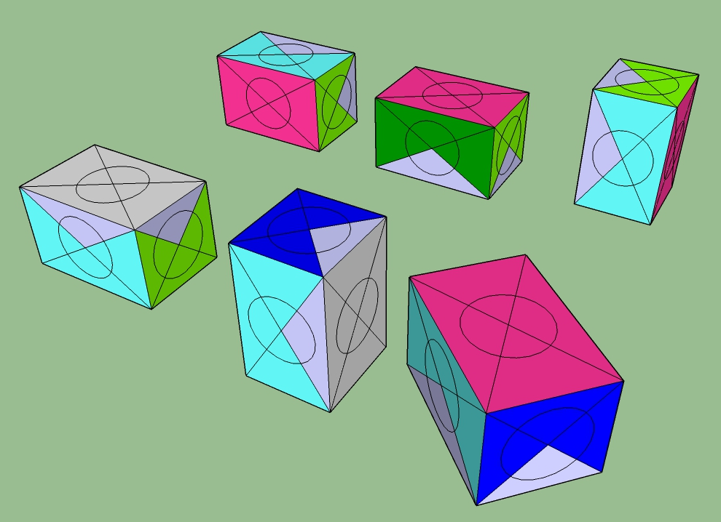
Let’s use a multicolored box for a thought experiment

Slide 9
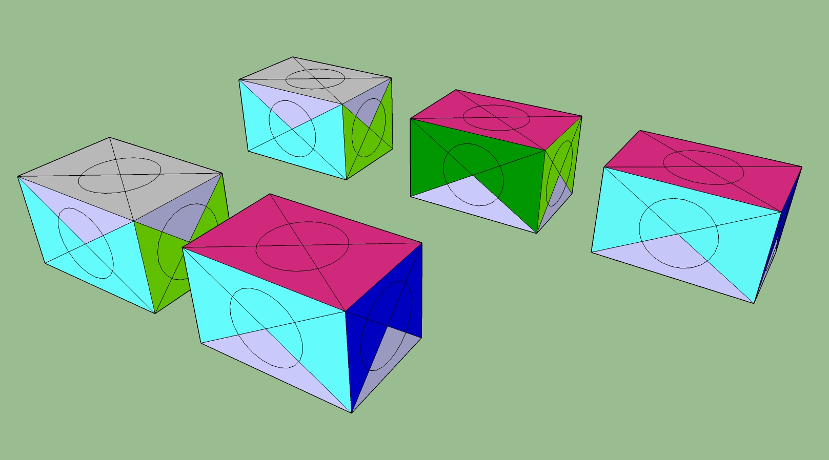
There’s more than one way to get from A to B
A
A
B
B

Slide 10
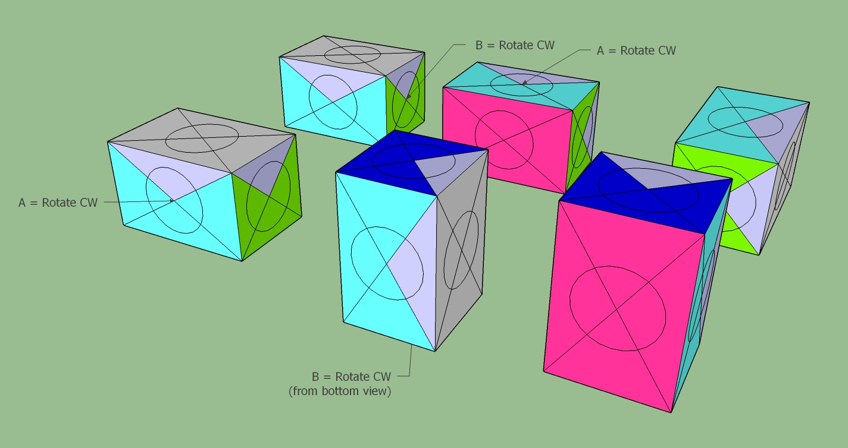
Rotations Do NOT Commute A followed by B ≠ B followed by A

Slide 11
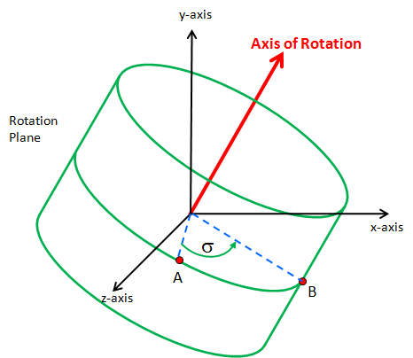
There are multiple representations for rotation
Options include:
Euler Angles – intuitive (roll, pitch & yaw), but subject to gimbal lock
Rotation Matrices – rotation as a matrix multiplication
Axis / Angle – easy to understand, difficult to use
Quaternions – similar to axis/angle, with a theoretical background that makes them useful
axis/angle
Euler Angle Illustration
source: http://en.wikipedia.org/wiki/File:Euler2a.gif

Slide 12
Euler Angles

Slide 13
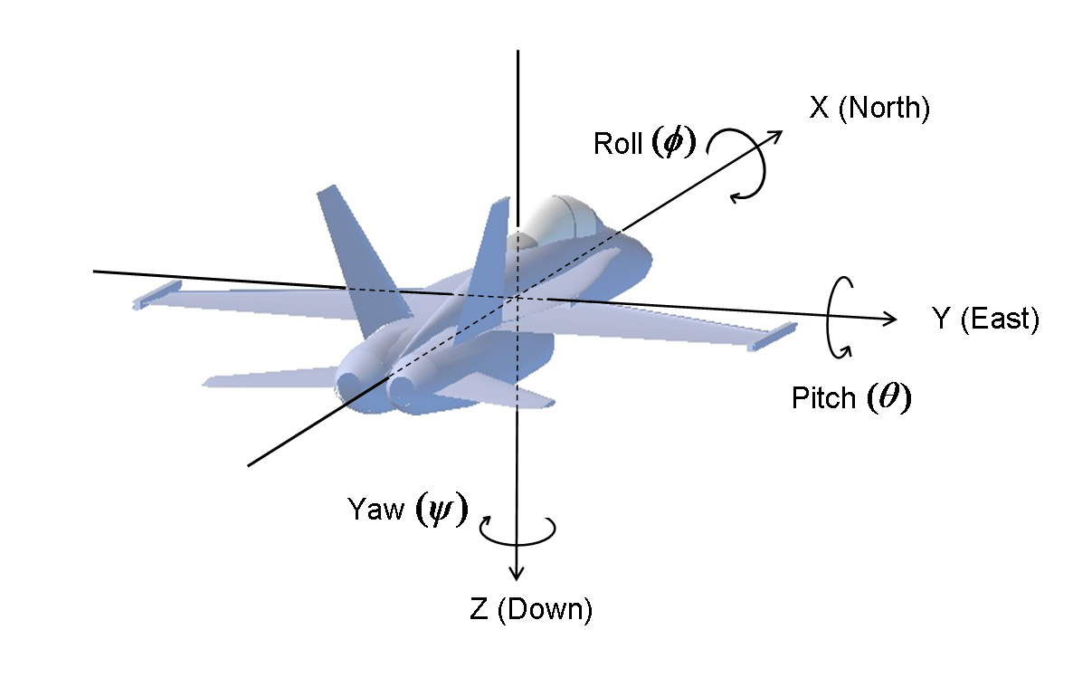
Aerospace Frame of Reference (NED)
source: http://www.chrobotics.com/library/understanding-euler-angles

Slide 14
There are 12 possible sequences
Alpha | Angles | Comments
YRP | ψ-Φ-θ | Tait-Bryan angles (AKA Nautical or Cardan angles) | All of these are sometimes referred to simply as “Euler Angles”
YPR | ψ-θ-Φ
PYR | θ-ψ-Φ
PRY | θ-Φ-ψ
RYP | Φ-ψ-θ
RPY | Φ-θ-ψ
RYR | Φ-ψ-Φ | Proper Euler Angles
RPR | Φ-θ-Φ
PYP | θ-ψ-θ
PRP | θ-Φ-θ
YRY | ψ-Φ-ψ
YPY | ψ-θ-ψ

Slide 15
Rotation Polarity
+Z
We use the Right Hand System (RHR) to define positive polarity.
The red arrows show positive rotation about each of the three axes.
ω_{z}
+X
ω_{x}
+Y
ω_{y}

Slide 16
Euler Intrinsic vs Extrinsic Rotations
Intrinsic rotations are elemental rotations that occur about the axes of a coordinate system XYZ attached to a moving body. Therefore, they change their orientation after each elemental rotation.
Extrinsic rotations are elemental rotations that occur about the axes of the fixed coordinate system xyz. The XYZ system rotates, while xyz is fixed.
We use “Intrinsic” as our standard
Source: Wikipedia

Slide 17
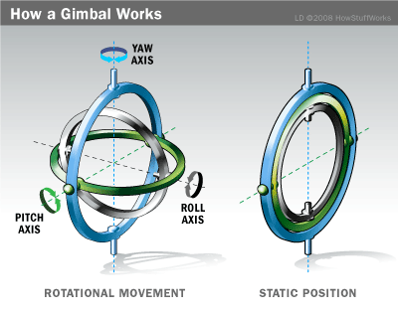
source: http://science.howstuffworks.com/gimbal1.htm

Slide 18
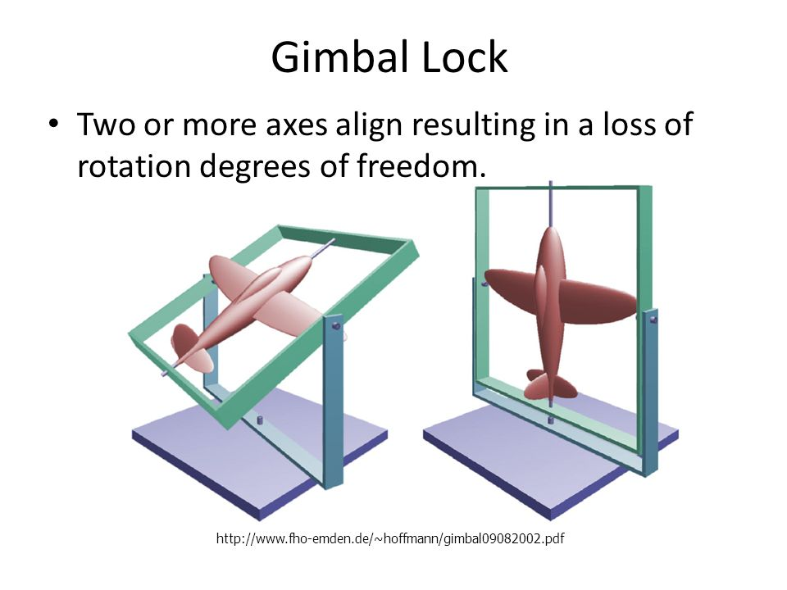

Slide 19
Interesting aside…
Gimbal lock is related to the singularities in longitude that you get at the north and south poles
Source: CSE169: Computer Animation Class Notes, Instructor: Steve Rotenberg UCSD, Winter 2005

Slide 20
Frame of Reference Variations
 | NED | Android | Windows 8
Axes alignment | NED | ENU | ENU
Angle rotation order | Yaw then pitch then roll | Yaw then roll then pitch | Yaw then pitch then roll
Gimbal lock | Roll instability (X-axis) at ±90 deg pitch (Y-axis) | Pitch instability (X-axis) at ±90 deg roll (Y-axis) | Roll instability (Y-axis) at ±90 deg pitch (X-axis)
Roll range | Clockwise¹ –180 to 180 deg | Anti-clockwise –90 to 90 deg | Clockwise¹ –90 to 90 deg
Pitch range | –90 to 90 deg | –180 to 180 deg | –180 to 180 deg
Yaw range | 0 to 360 | 0 to 360 | 0 to 360
Compass heading | Yaw | Yaw | –Yaw

Slide 21
Euler Angles are compact and intuitive, but…
Rotation order matters!
There is no simple way to concatenate rotations
There almost as many notations for Euler angles as the references in which they appear. Be specific in your notation.
There may be multiple Euler angle combinations which map to the same physical rotation. They are not unique.
There are typically limits on the range of Euler rotation for each axis (+/- π or +/- π/2), which can lead to discontinuities in representation.
Smooth interpolation between points is problematic.
Euler angles have very poor mathematical properties in comparison with rotation matrices and quaternions, and should be avoided.

Slide 22
Axis / Angle

Slide 23
Rotation Vectors and Axis/Angle
Euler’s Theorem also shows that any two orientations can be related by a single rotation about some axis (not necessarily a principle axis)
This means that we can represent an arbitrary orientation as a rotation about some unit axis by some angle (4 numbers) (Axis/Angle form)
Alternately, we can scale the axis by the angle and compact it down to a single 3D vector (Rotation vector)
Source: CSE169: Computer Animation Class Notes, Instructor: Steve Rotenberg UCSD, Winter 2005

Slide 24
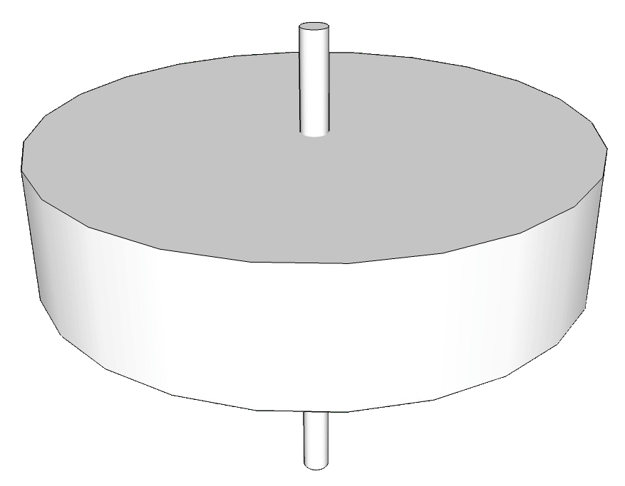
Axis = [X, Y, Z]
Angle = α
origin

Slide 25
Axis/Angle Representation
Storing an orientation as an axis and an angle uses 4 numbers, but Euler’s theorem says that we only need 3 numbers to represent an orientation
Mathematically, this means that we are using 4 degrees of freedom to represent a 3 degrees of freedom value
This implies that there is possibly extra or redundant information in the axis/angle format
The redundancy manifests itself in the magnitude of the axis vector. The magnitude carries no information, and so it is redundant. To remove the redundancy, we can normalize the axis, thus constraining the extra degree of freedom
Source: CSE169: Computer Animation Class Notes, Instructor: Steve Rotenberg UCSD, Winter 2005

Slide 26
Rotation Matrices

Slide 27
Consider
Rotating Reference frame = body frame
Y_{earth}
Y_{body}
X_{body}
O_{e}
X_{earth}
O_{b}
Z_{earth}
Z_{body}
Fixed Reference frame = Local Earth Frame

Slide 28
Consider
Rotating Reference frame = body frame
Y_{earth}
Y_{body}
X_{body}
O_{e}
X_{earth}
O_{b}
Z_{earth}
Z_{body}
Fixed Reference frame = Local Earth Frame

Slide 29
How does Vector A in the body frame look when viewed from the earth frame?
A_{body} = (x_{b} y_{b} z_{b})^{T}
A_{earth} = (x_{e} y_{e} z_{e})^{T}
X_{body} and Y_{body} are body axes
X_{earth} and Y_{earth} are local earth axes
Y_{earth}
Y_{body}
A
X_{body}
X_{earth}
O

Slide 30
Rotation of Body Frame about Z axis
x_{e} = x_{b} cos(Ψ) - y_{b} sin(Ψ)
y_{e} = x_{b} sin(Ψ) + y_{b} cos(Ψ)
A_{body} = (x_{b} y_{b} z_{b})^{T}
A_{earth} = (x_{e} y_{e} z_{e})^{T}
X_{body} and Y_{body} are body axes
X_{earth} and Y_{earth} are local earth axes
cosΨ | -sinΨ | 0
sinΨ | cosΨ | 0
0 | 0 | 1
A_{earth} =
A_{body}
Y_{earth}
Y_{body}
R_{-Ζ}
Ψ
A
y_{e}
Ψ
x_{b}sinΨ
|y_{b}|
Ψ
Ψ
X_{body}
y_{b}
cosΨ | sinΨ | 0
-sinΨ | cosΨ | 0
0 | 0 | 1
A_{body} =
A_{earth}
x_{b}
y_{b}cosΨ
Ψ
x_{e}
X_{earth}
O
R_{Ζ}
x_{b}cosΨ
Y_{b}sinΨ

Slide 31
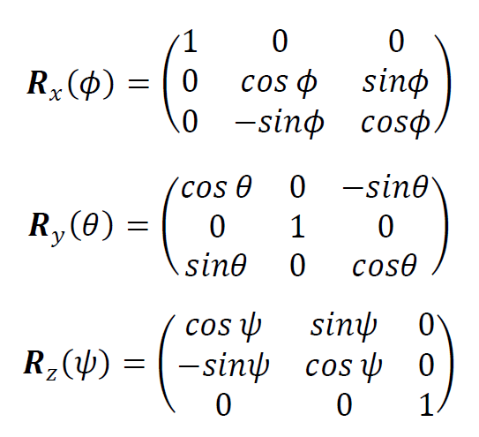
In a similar fashion…

Slide 32
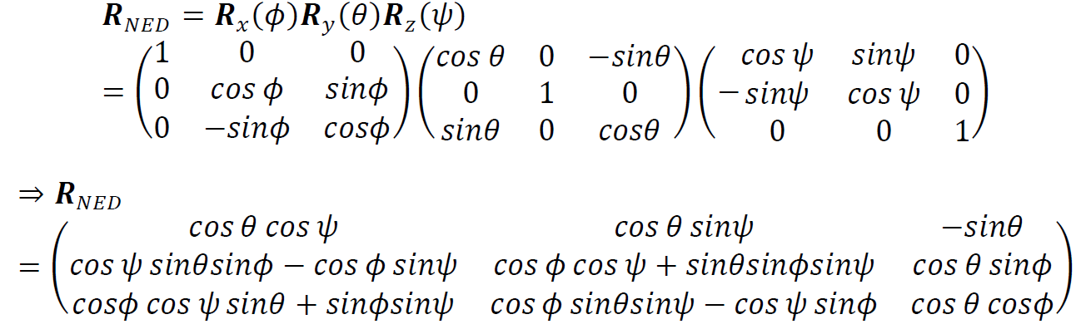
Stringing these together… and assuming standard NED sequence…
A_{body} = R_{NED} * A_{earth}
To translate from body to earth frame, take the inverse of R_{NED}.
The inverse of a rotation matrix is simply it’s transpose.

Slide 33
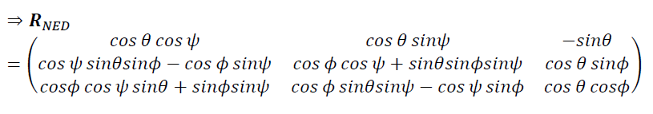
For small signals… sin(x)=>x and cos(x)=>1
1 | ψ | -θ
-ψ | 1 | φ
θ | -φ | 1
=
Very small angle rotations are linear!

Slide 34
Take the time derivative
1 | ψ | -θ
-ψ | 1 | φ
θ | -φ | 1
R_{NED} =
0 | ω_{z} | -ω_{y}
-ω_{z} | 0 | ω_{x}
ω_{y} | -ω_{x} | 0
dD(R_{NED)}/dx =

Slide 35
Application Insight…
Matrix entries in the derivative relate directly to gyro values
Recall:
A_{body} = R_{NED} * A_{earth}
If A_{earth} = [0 0 g]^{T} and/or B[cosδ b sinδ]^{T}
where
δ is the inclination angle of the magnetic field relative to the horizontal plane
Then you can immediately see the basis for “virtual gyros”

Slide 36
Quaternions i² = j² = k² = ijk = -1

Slide 37
Quaternions are Hyper-Complex Numbers
Invented by Hamilton in 1843
Quaternions are a 4-dimensional extension to complex numbers
The first coefficient is a ‘real’ scalar number
The other 3 coefficients form a vector

Slide 38
Why should we care?
Quaternions provide alternate representation to Euler angles and rotation matrices.
Quaternions are more efficient:
require less storage
require fewer math operations
are not subject to "gimbal-lock"

Slide 39
Insights:
The quaternion product is not commutative
A multiplicative inverse exists for every non-zero quaternion
We concern ourselves only with quaternions of unit length (i.e. unit quaternions)
Unit quaternions can be used to model rotations
Conventions:
Quaternion denoted by lower case letter:
ex: p or q or r
Bold face letters denote ordinary vectors in R³

Slide 40
Different ways to write the same quaternion
We can write quaternions as elements of R⁴:
q = (q₀, q₁, q₂, q₃)
We can also write:
q = q₀ + q, where q = iq₁ + jq₂ + kq₃
OR
q = cos θ + u sin θ
where :
u = q₁i + q₂j + q₃k
u = the axis of rotation
2θ = the rotation about u

Slide 41
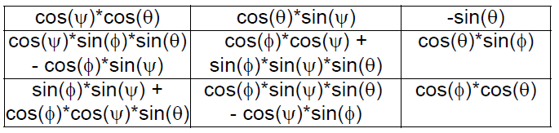
Quaternions are an efficient representation
Versus
q = cos θ + u sin θ
where :
u = q₁i + q₂j + q₃k
u = the axis of rotation
2θ = the rotation about u

Slide 42
Equality
If:
p = p₀ + ip₁ + jp₂ + kp₃
q = q₀ + iq₁ + jq₂ + kq₃
Then p = q if and only if
p₀ = q₀
p₁ = q₁
p₂ = q₂
p₃ = q₃

Slide 43
The Sum of Two Quaternions
If:
p = p₀ + ip₁ + jp₂ + kp₃
q = q₀ + iq₁ + jq₂ + kq₃
Then:
p + q = (p₀ + q₀) + i(p₁+q₁) + j(p₂+q₂) + k(p₃+q₃)
Addition of two quaternions is commutative:
p + q = q + p

Slide 44
Multiplication of Quaternion by Scalar
If:
c = scalar
q = q₀ + iq₁ + jq₂ + kq₃
Then:
cq = cq₀ + icq₁ + jcq₂ + kcq₃

Slide 45
The Complex Conjugate of a Quaternion
If q = q₀ + q = q₀ + iq₁ + jq₂ + kq₃ , then
q* = q₀ - q = q₀ - iq₁ - jq₂ - kq₃
(pq)* = q*p*
q + q* = 2 q₀

Slide 46
The norm of a quaternion
the norm of q = length of q = |q|
N(q) = square root of q*q
N(q) = square root of (q₀² + q₁² + q₂² + q₃²)
The norm of the product of two quaternions = the product of the individual norms

Slide 47
The Inverse of the Quaternion
q⁻¹ = q* / |q|²
For a unit quaternion: q⁻¹ = q*

Slide 48
Implications
Taking the inverse of a rotation quaternion inverts the sense of rotation!
You could also get the same effect by inverting just q₀
Taken together, these imply that q₀ and –q₀ model the same orientation!
This can cause problems when interpolating between two quaternions. We solve this problem by selectively inverting a quaternion when the dot product of it with the previous value is less than zero. This forces the “shortest path” between successive quaternions. Alternately, just always force q₀ to be greater than zero.

Slide 49
Refresher: dot & cross products for 3D vectors
If a = (a₁, a₂, a₃) and b = (b₁, b₂, b₃)
Then
a•b = a₁b₁ + a₂b₂ + a₃b₃
The dot is commutative; that is: a • b = b • a
a x b = (a₂b₃-a₃b₂)i + (a₃b₁-a₁b₃)j + (a₁b₂-a₂b₁)k
=
i | j | k
a₁ | a₂ | a₃
b₁ | b₂ | b₃
The cross product is not commutative; that is:
a x b ≠ b x a

Slide 50
Product of Two Quaternions
The product is not commutative.
pq = p₀q₀ - p•q + p₀q + q₀p + p x q
Note that product of two quaternions is another quaternion
scalar
vector

Slide 51
Vector Representation of Quaternion Product
pq = p₀q₀ - p•q + p₀q + q₀p + p x q
Can be expanded to:
p₀q₁ + p₁q₀ + p₂q₃ - p₃q₂
p₀q₂ – p₁q₃ + p₂q₀ + p₃q₁
p₀q₃ + p₁q₂ - p₂q₁ + p₃q₀
pq = p₀q₀ – p₁q₁ + p₂q₂ + p₃q₃,

Slide 52
Quaternion Multiplication
Note that two unit quaternions multiplied together will result in another unit quaternion
This corresponds to the same property of complex numbers
Remember that multiplication by complex numbers can be thought of as a rotation in the complex plane
Quaternions extend the planar rotations of complex numbers to 3D rotations in space

Slide 53
Quaternion Dot Products
The dot product of two quaternions works in the same way as the dot product of two vectors:
The angle between two quaternions in 4D space is half the angle one would need to rotate from one orientation to the other in 3D space
Source: CSE169: Computer Animation Class Notes, Instructor: Steve Rotenberg UCSD, Winter 2005

Slide 54
Quaternion Rotation Operator
For any unit quaternion
q = q₀ + q = cos θ + u sin θ
and for any vector v Є R³ the action of the operator
Let quaternion v = [0 v_{x} v_{y} v_{z}], then
L_{q}(v) = w = qvq*
on v may be interpreted geometrically as a rotation of the vector v through an angle 2θ about q as the axis of rotation

Slide 55
Quaternion Rotation Operator
y-axis
q = Rotation
Axis
q = Rotation
Axis
Rotation
Plane
sin(θ)
m
n
v
w
x-axis
v = a+n
w = qvq*
w = a+m
2θ
θ
θ
v
w
a
z-axis
cos(θ)
Note: v and w are different vectors in left & right representations

Slide 56
Sequences of Rotations
Suppose that p and q are unit quaternions which define the quaternion rotation operators
L_{p}(u) = pup* and L_{q}(v) = qvq*
Then the quaternion product qp defines a quaternion rotation operator L_{qp} which represents a sequence of operators, L_{p} followed by L_{q}. The axis and the angle of rotation are those represented by the quaternion product, r = qp.

Slide 57
Sequences of Rotations
L_{p}
L_{q}
u
v=L_{p}(u)
w=L_{q}(v)
v = L_{p}(u) = pup*
w = L_{q}(v) = qvq* = q(pup*)q*
w = (qp)u(qp)*
w = L_{qp}(u)

Slide 58
Multiple Rotations
IF:
p and q are unit quaternions and
we apply rotation based on p then q;
w = q(pup*)q*
=(qp)u(qp)*
= L_{qp}(u)
So product of qp calculated before rotation function is equivalent to two separate rotations.

Slide 59
The Quaternion Time Derivative Relates to Angular Velocity…
q(t) = (1/2) q(t) ω(t)
Where ω(t) = {0, ω_{x}, ω_{y}, ω_{z}}

Slide 60
Quaternion to Rotation Matrix
To convert a quaternion to a rotation matrix:
Source: CSE169: Computer Animation Class Notes, Instructor: Steve Rotenberg UCSD, Winter 2005

Slide 61
Alternate Form
To convert a quaternion to a rotation matrix:
The diagonals have been changed into an equivalent form
Source: CSE169: Computer Animation Class Notes, Instructor: Steve Rotenberg UCSD, Winter 2005

Slide 62
Rotation Matrix to Quaternion
Given:
=
We can show:
q₀ = (1/2) sqrt(m₁₁+m₂₂+m₃₃+1)
q₁ =(m₂₃-m₃₂)/(4q₀)
q₂ = (m₃₁-m₁₃)/(4q₀)
q₃ = (m₁₂ – m₂₁)/(4q₀)

Slide 63
Some useful (normalized) quaternions
w | x | y | z | Description
1 | 0 | 0 | 0 | Identity quaternion, no rotation
0 | 1 | 0 | 0 | 180' turn around X axis
0 | 0 | 1 | 0 | 180' turn around Y axis
0 | 0 | 0 | 1 | 180' turn around Z axis
sqrt(0.5) | sqrt(0.5) | 0 | 0 | 90' rotation around X axis
sqrt(0.5) | 0 | sqrt(0.5) | 0 | 90' rotation around Y axis
sqrt(0.5) | 0 | 0 | sqrt(0.5) | 90' rotation around Z axis
sqrt(0.5) | -sqrt(0.5) | 0 | 0 | -90' rotation around X axis
sqrt(0.5) | 0 | -sqrt(0.5) | 0 | -90' rotation around Y axis
sqrt(0.5) | 0 | 0 | -sqrt(0.5) | -90' rotation around Z axis
Note: these assume zero value in vector axis used as rotation axis. They are NOT 100% applicable.
from: http://www.ogre3d.org/tikiwiki/Quaternion+and+Rotation+Primer&structure=Tutorials#Some_useful_normalized_quaternions

Slide 64
Final Observations

Slide 65
Suggestions / Comments
Never, never, never use Euler angles for computation purposes
Axis / Angle representations are intuitive when considering angular rate problems, but otherwise best avoided. Use quaternions instead, as they contain similar information.
Rotation matrices have no singularities, but are not as efficient as quaternions.
It’s easy to go back and forth between rotation matrices and quaternions.
Don’t worry about the underlying complexity of quaternion math. Code the subroutines once and just use them.

Slide 66
Quaternions vs Rotation Matrix Pros & Cons
Topic | Quaternion | Rotation Matrix
Storage | Requires 16 bytes of storage in single precision floating point (4 elements at 4 bytes each) | Requires 36 bytes of storage (9 elements at 4 bytes each)
Computation (for 2 sequential rotations) | 4 elements each requiring 4 multiplies and 3 additions = 28 operations | 9 elements, each requiring 3 multiplies and 2 additions = 45 operations
Vector rotation | Rotating a vector by pre- and post-multiplication of quaternion requires 52 operations | Rotating a vector via rotation matrix requires 15 operations (3 elements each requiring 3 multiplies and 2 additions)
Discontinuities | Generally, we force the scalar part of the quaternion to be positive, which can cause a discontinuity in the rotation axis (it flips). | None
Ease of Understanding | Generally takes a lot of study to understand the details | Easily understood by most engineers

Slide 67
References
NXP AN5017: Aerospace Android and Windows Coordinate System
NXP AN5022: Quaternion Algebra and Rotations
NXP Sensor Fusion User Guide
Quaternions and Rotations by Jack B. Kuipers
Quaternions, Ken Shoemake, University of Pennsylvania
Rotation Representations and Performance Issues, David Eberly, Geometric Tools, LLC
Representing Attitude: Euler Angles, Unit Quaternions and Rotation Vectors, James Diebel, Stanford University

Slide 68
Supplementary material

Slide 69
The following derivation is based upon one found at http://www.euclideanspace.com/maths/algebra/vectors/angleBetween/index.htm
Determining the quaternion necessary to rotate vector V1 into V2

Slide 70
q = q₀ + q = cos θ + u sin θ (1)
Let φ= 2θ (2)
q = cos (φ/2) + u sin (φ/2) (3)
u = V₁XV₂ / || V₁XV₂ || (4)
Identity: cos φ = V₁.V₂ / || V₁|| ||V₂|| (5)
Identity: sin φ = 2 sin (φ/2) cos (φ/2) (6)
sin (φ/2) = 1/2 sin φ / cos (φ/2) (7)
q = cos (φ/2) + (1/2 sin φ / cos (φ/2)) V₁XV₂ / || V₁XV₂ || (8)
Multiply by 2 cos (φ/2)
2 cos (φ/2) q = 2cos² (φ/2) + sin φ V₁XV₂ / || V₁XV₂ || (9)
Identity: cos φ = 2 cos² (φ/2) − 1 (10)
2 cos² (φ/2) = cos φ + 1 (11)
2 cos (φ/2) q = (cos φ + 1) + sin φ V₁XV₂ / || V₁XV₂ || (12)
Identity: || V₁XV₂ || = || V₁ || || V₂ || sin φ (13)

Slide 71
From Prior page
2 cos (φ/2) q = (cos φ + 1) + sin φ V₁XV₂ / || V₁XV₂ || (12)
Identity: || V₁XV₂ || = || V₁ || || V₂ || sin φ (13)
2 cos (φ/2) q = (cos φ + 1) + sin φ V₁XV₂ / (|| V₁ || || V₂ || sin φ) (14)
2 cos (φ/2) q = (cos φ + 1) + V₁XV₂ / (|| V₁ || || V₂ ||) (15)
substitute (5) into (15)
2 cos (φ/2) q = (V₁.V₂ / || V₁|| ||V₂|| + 1) + V₁XV₂ / (|| V₁ || || V₂ ||) (15)
Multiply everything by (|| V₁ || || V₂ ||)
2 cos (φ/2) (|| V₁ || || V₂ ||) q = (V₁.V₂ + || V₁|| ||V₂||) + V₁XV₂ (16)
Simplify by renormalizing and we have
q = norm((V₁.V₂ + || V₁|| ||V₂||) + V₁XV₂) (17)

Slide 72
Averaging Quaternions
Gene Brownd, in "Averaging and Interpolating Quaternions", states that a reasonable estimate of the average of a bunch of quaternions can be obtained by the simple expediant of averaging the components, subject to the following:
quaternions must be normalized before averaging
the resulting average must be normalized
the angles between quaternions should be less than 180°
A more rigorous (and complex) approach is presented by Markley, et. al. in "Averaging Quaternions"

Slide 73
The Unit Circle
0,1
tan=∞
sin=+
cos=-
tan=-
sin=+
cos=+
tan=+
Ψ=180-α
x=cos(α), y=sin(α)
Ψ=α
x=cos(α), y=sin(α)
hyptoneuse=1
-1,0
α
α
1,0
α
α
Ψ=180+α
x=cos(α), y=sin(α)
Ψ=360-α
x=cos(α), y=sin(α)
sin=-
cos=-
tan=+
sin=-
cos=+
tan=-
0,-1
tan=-∞

